Slide 1
Report of Marketing activities with sales agent by using marketing funds
Agent’s name pelicantravel.com
Country, city Czech Rep., Prague
Period 01/07/2018 – 31/12/2018

Slide 2



SU homepage banners on pelikan.sk

Slide 3




SU homepage banners on pelikan.cz

Slide 4

SU homepage banners on pelikan.cz

Slide 5
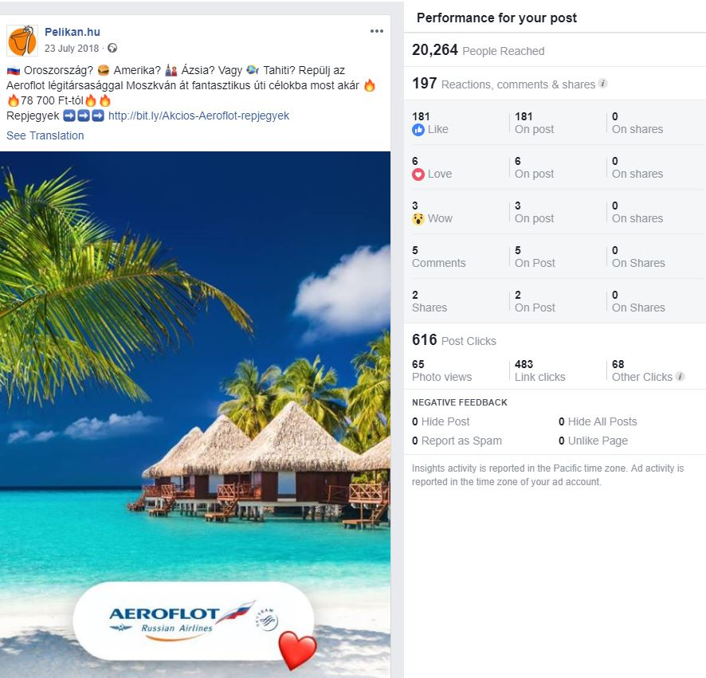
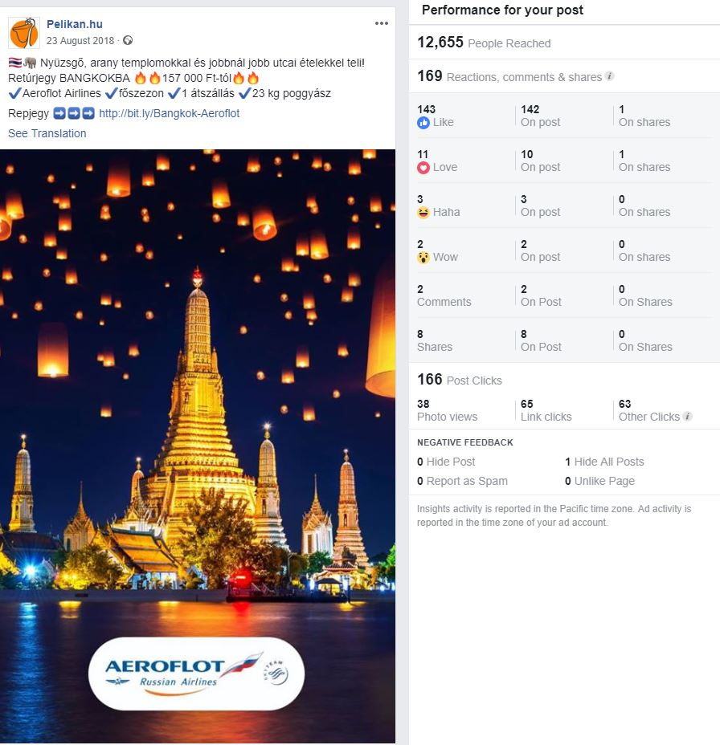
Joint Online advertising HU - Facebook
July 2018
August 2018

Slide 6
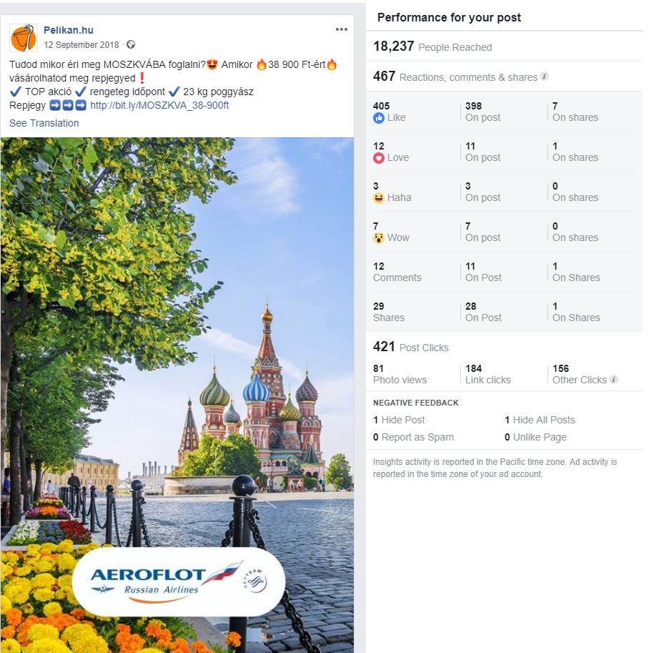
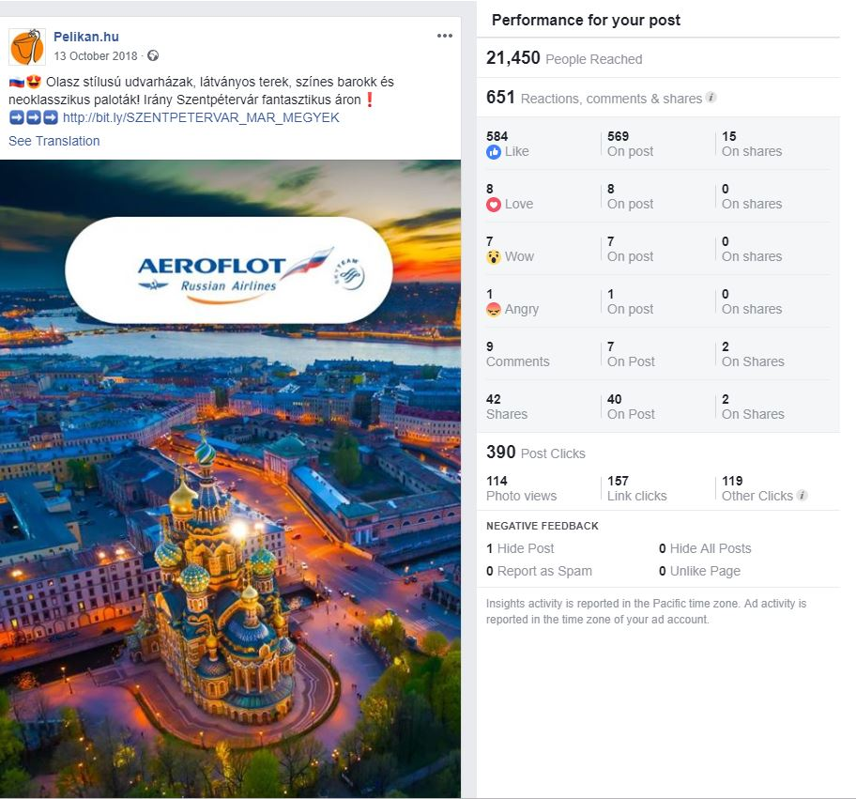
Joint Online advertising HU - Facebook
September 2018
October 2018

Slide 7
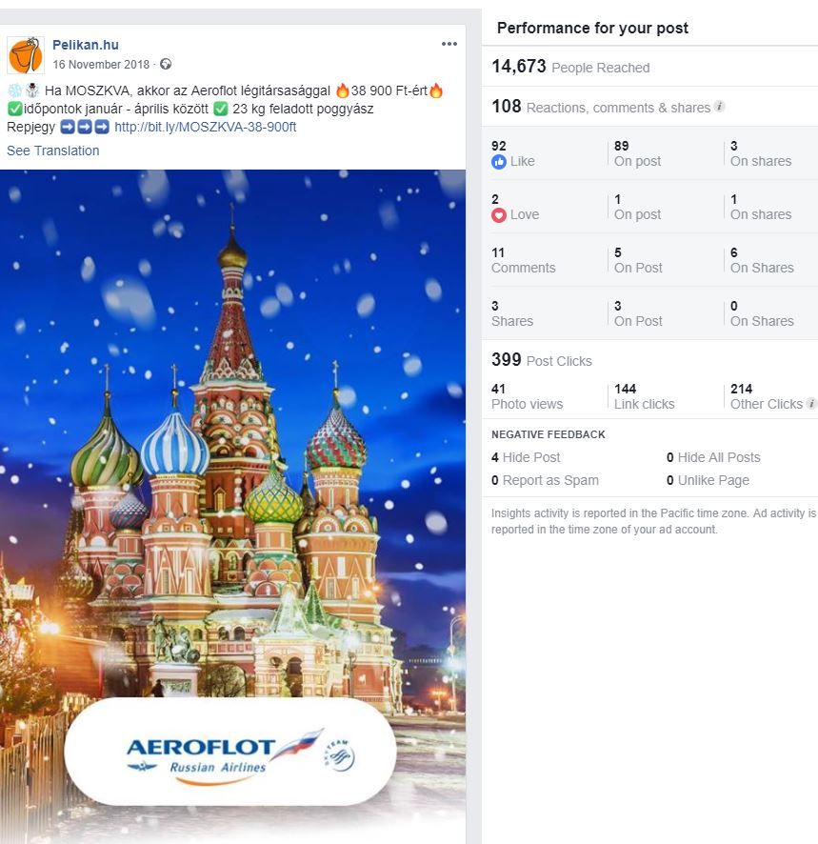
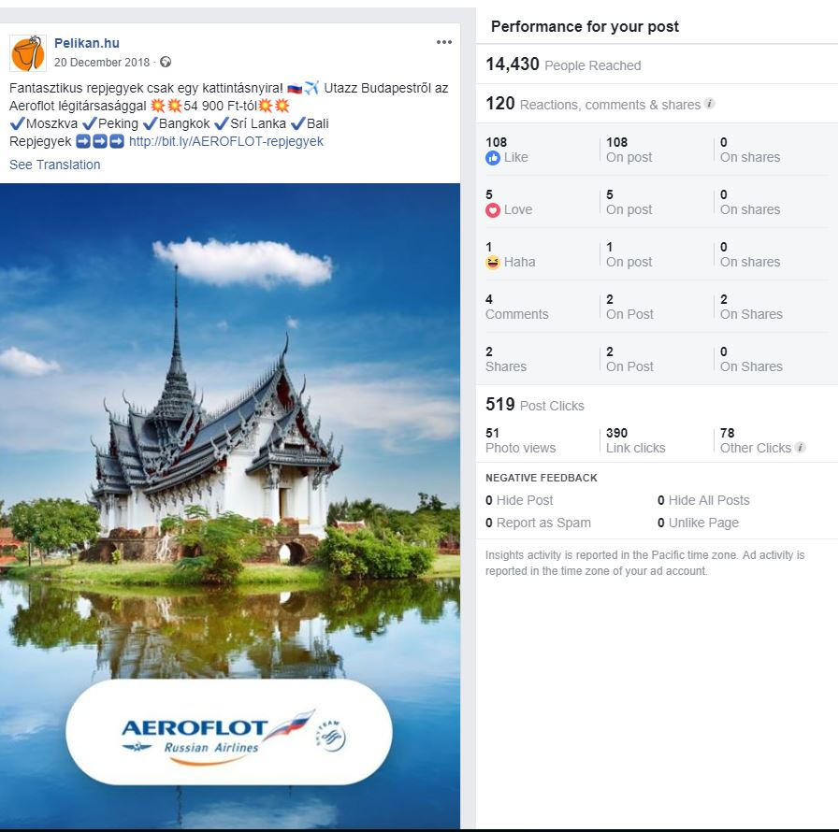
Joint Online advertising HU - Facebook
November 2018
December 2018

Slide 8
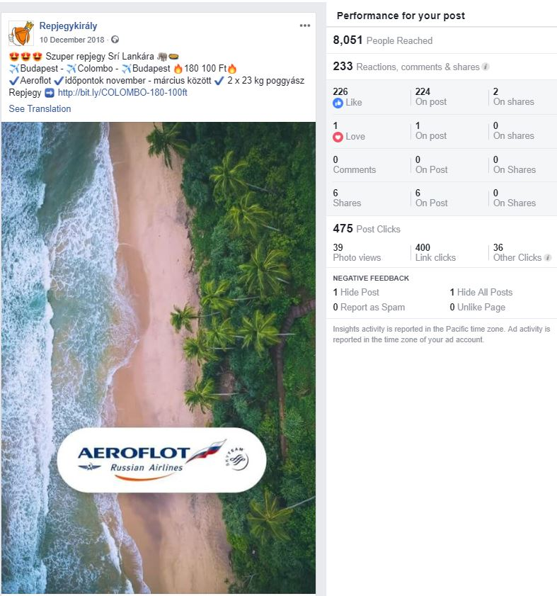
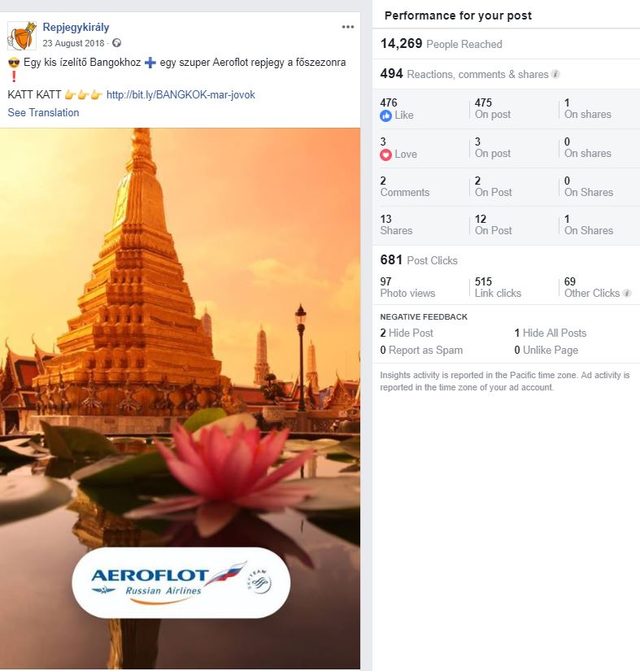
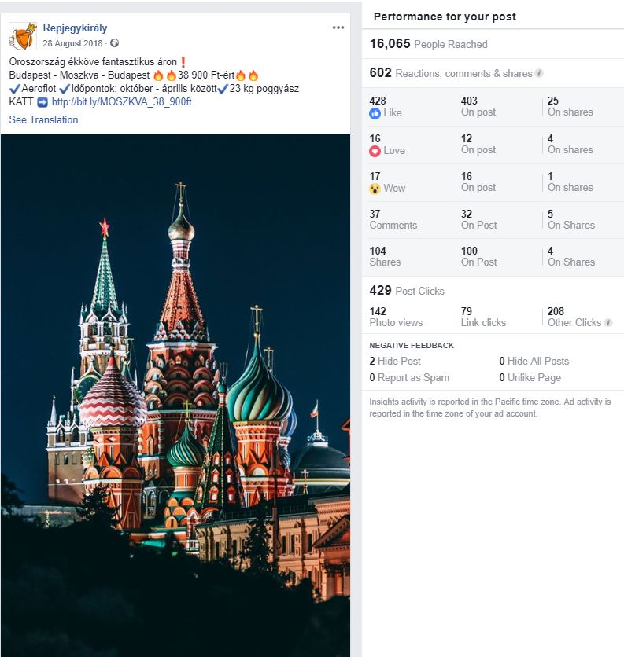
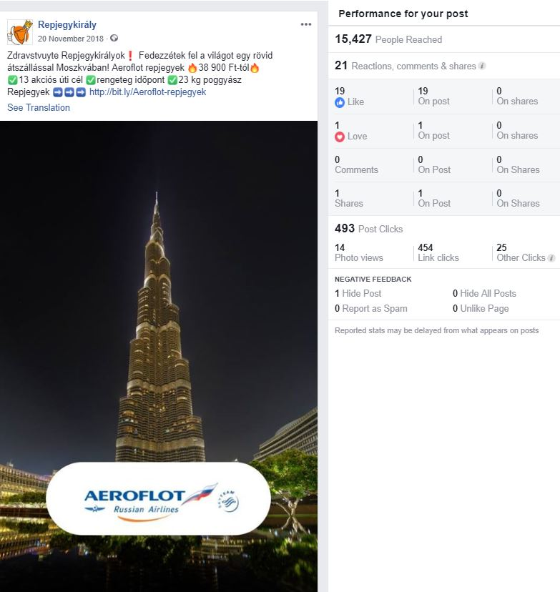
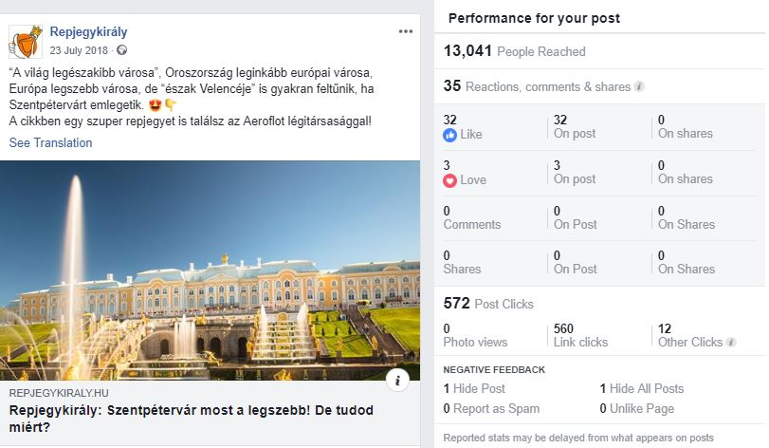
HU Facebook promo - Repjegykiraly

Slide 9
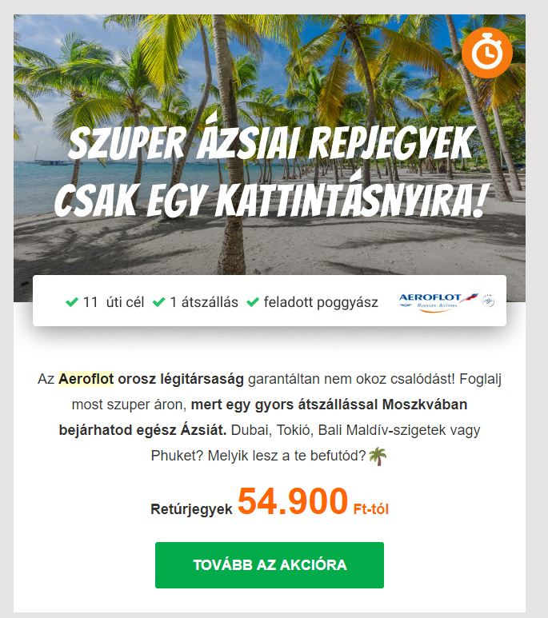
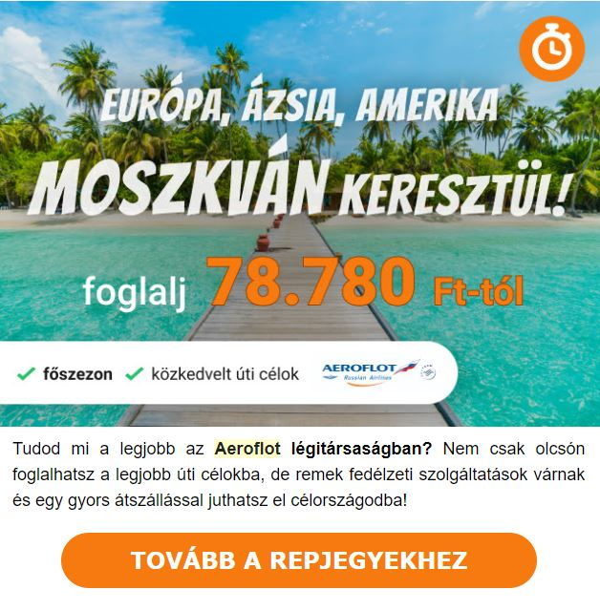
HU newsletter promo

Slide 10
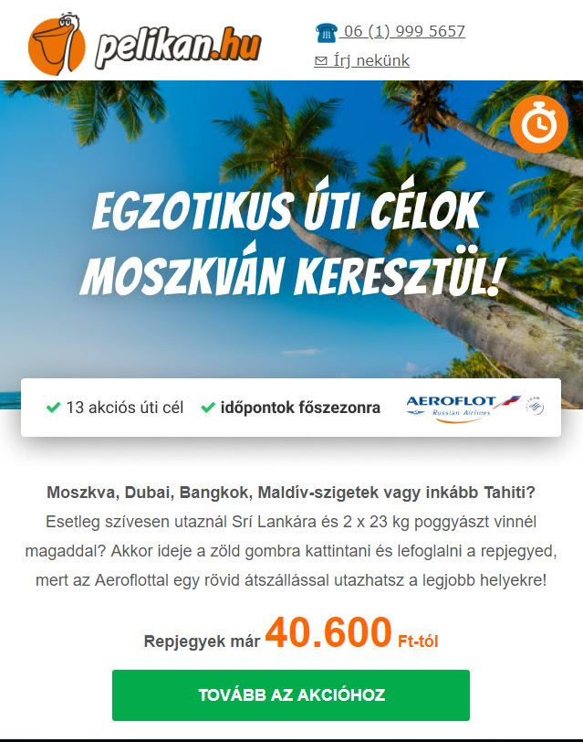

HU newsletter promo

Slide 11


HU newsletter promo

Slide 12



SU homepage banners on pelikan.hu

Slide 13



SU homepage banners on pelikan.hu

Slide 14
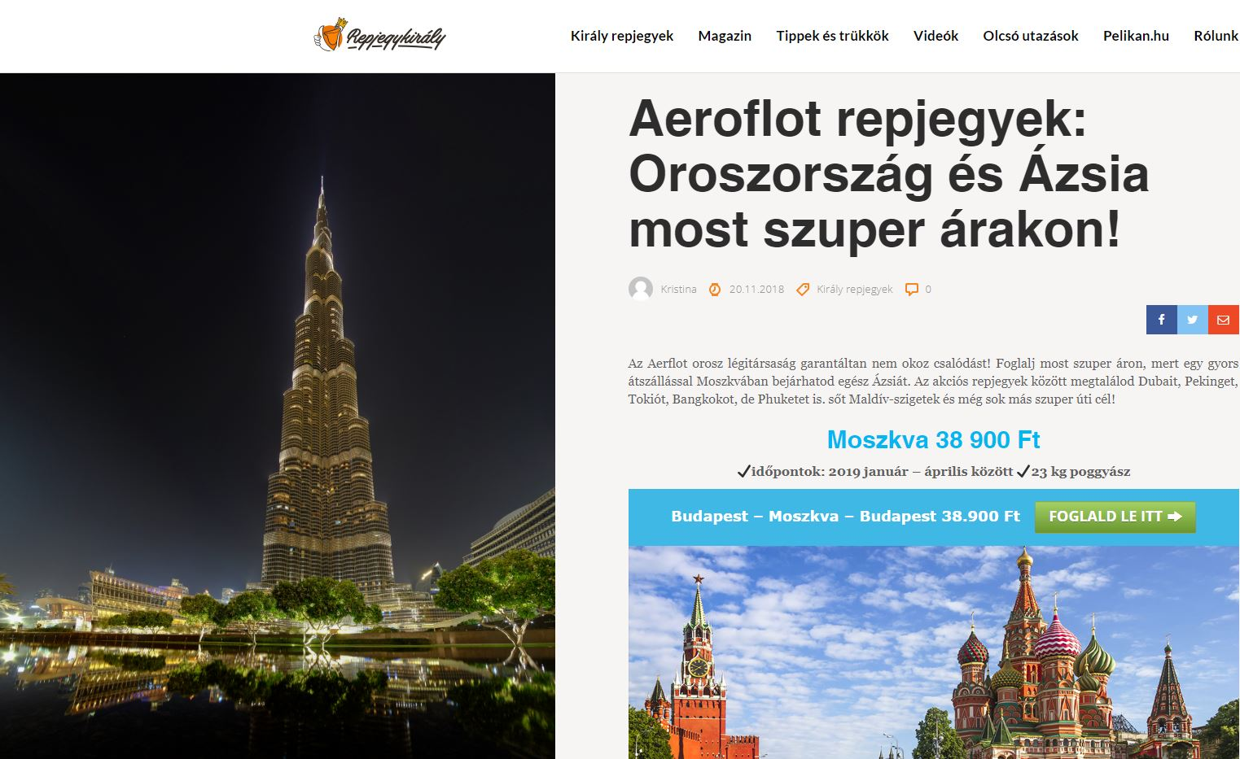
Articles on Repjegykiraly.hu

Slide 15
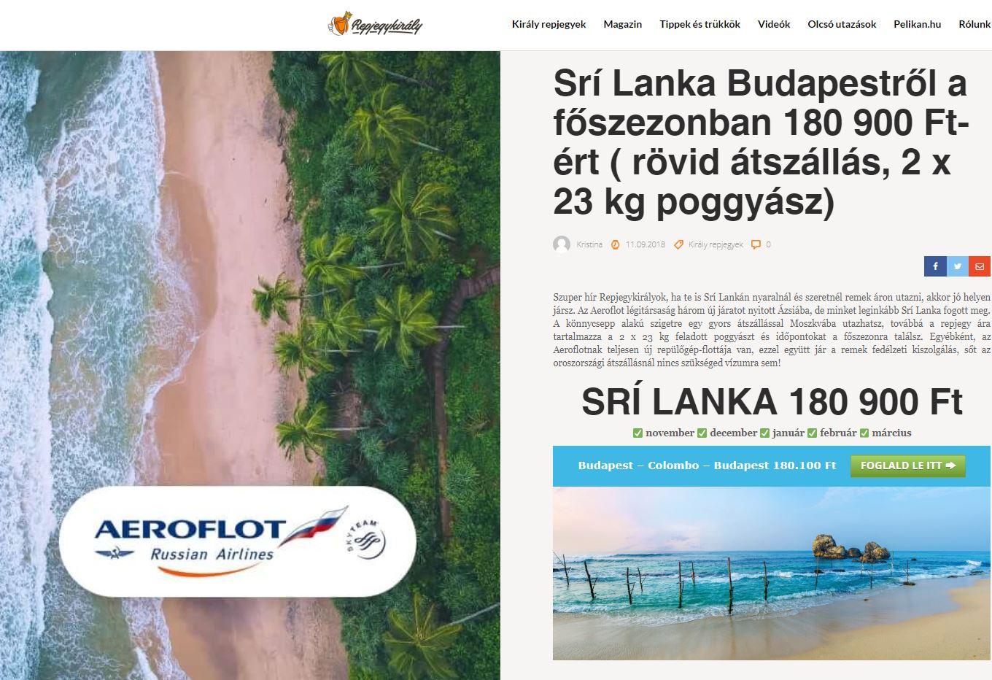
Articles on Repjegykiraly.hu

Slide 16
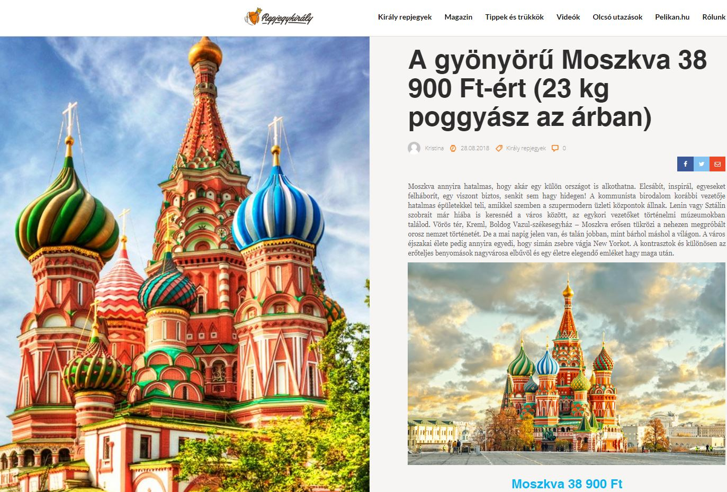
Articles on Repjegykiraly.hu

Slide 17
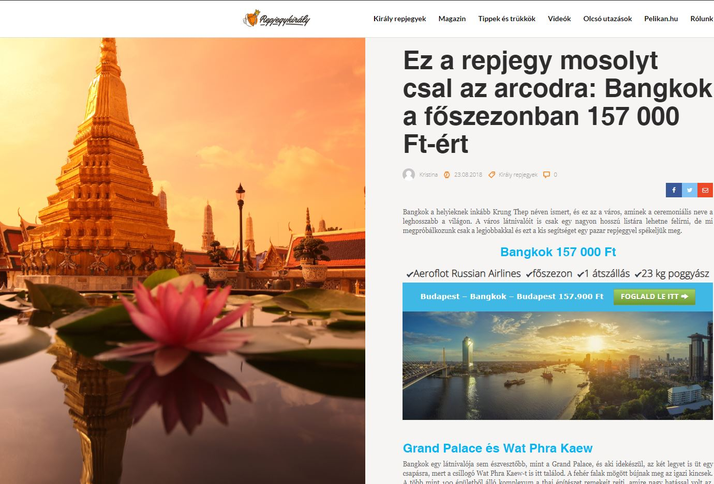
Articles on Repjegykiraly.hu

Slide 18
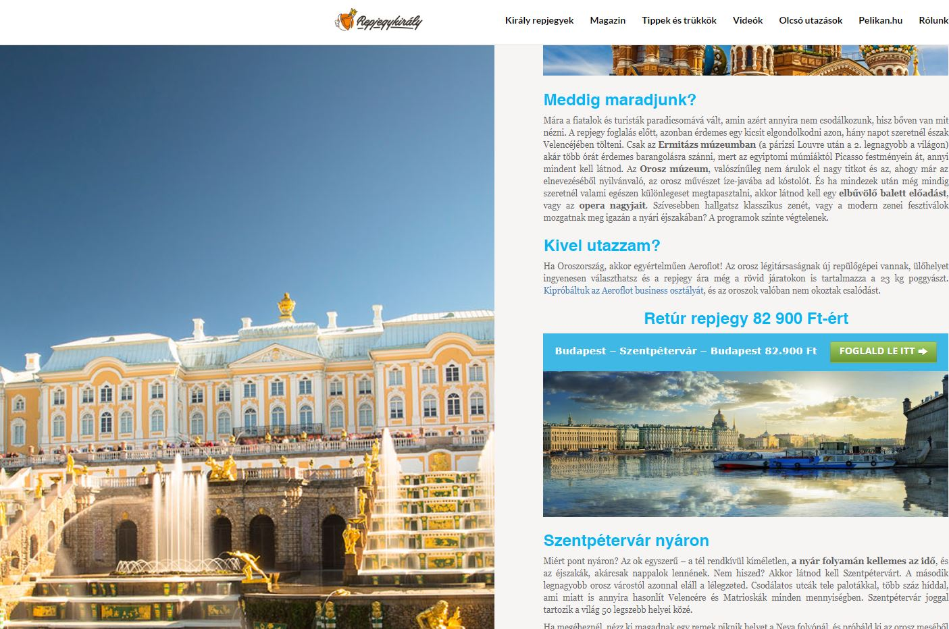
Articles on Repjegykiraly.hu

Slide 19
Comments/ recommendations/summary
Aeroflot is among the best partner with whom Pelikan company cooperates.
Cooperation with Aeroflot maintained at a professional level, thanks to regular activities carried out. Pelikan constantly actively working on a new marketing tools. It is in our great interest to show positive results to confirm your correct investments to marketing .Pelikan offers activities on more than 5 markets – Slovakian, Hungarian, Polish, Austrian and German, also Czech market.

