Slide 1

Pelikan & Air France
Amenity kit competitions on facebook
by

Slide 2
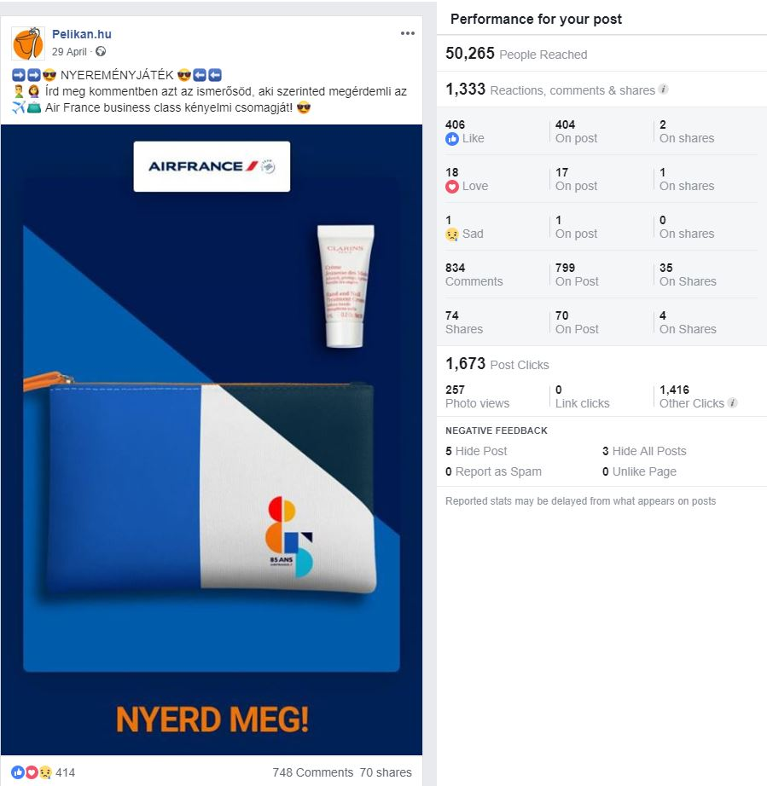

Pelikan.hu – business amenity kit
Terms of competition –
Mention a friend in comment section
Channel: only Facebook
Total reach: 50 265
Comments: 834
Shares: 70
by

Slide 3
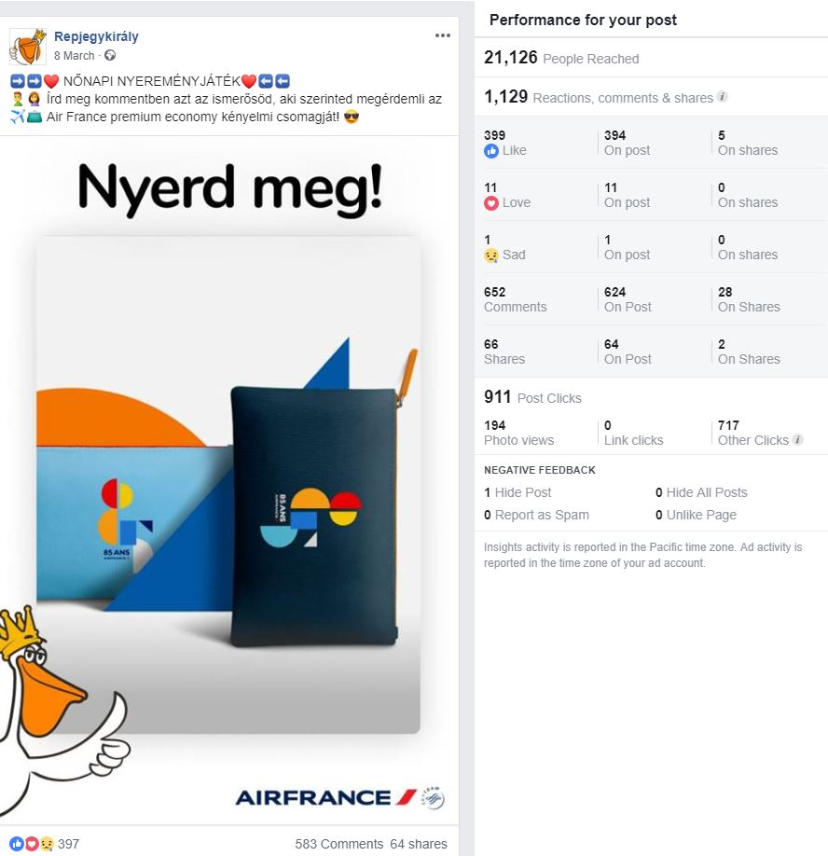

Repjegykirály – premium economy amenity kit
Terms of competition –
Mention a friend in comment section
Channel: only Facebook
Total reach: 21 126
Comments: 583
Shares: 64
by

Slide 4
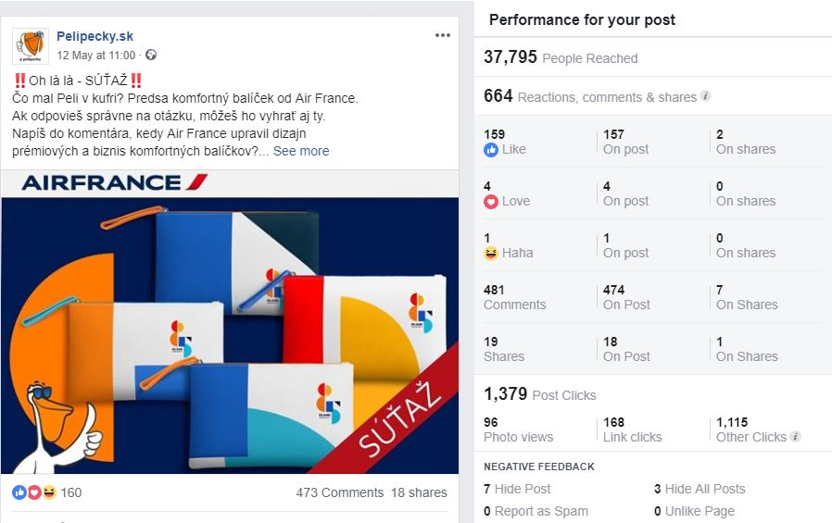

Pelipecky – premium economy amenity kit
Terms of competition –
Question
Channel: only Facebook
Total reach: 37 795
Comments: 481
Shares: 18
by

